Slide 1

Welcome
to NAME OF SCHOOL
school logo
name of CLC

Slide 2
A community school is not just another program being imposed on a school. It embodies a way of thinking and acting that recognizes the historic central role of schools in our communities — and the power of working together for a common good.
Educating our children, yes, but also strengthening our families and communities so that, in turn, they can help make our schools even stronger and our children even more successful.
- Ira Harkavy and Martin J. Blank
“A Vision of Learning That Goes Beyond Testing”
(Education Week, April 17, 2002)

Slide 3
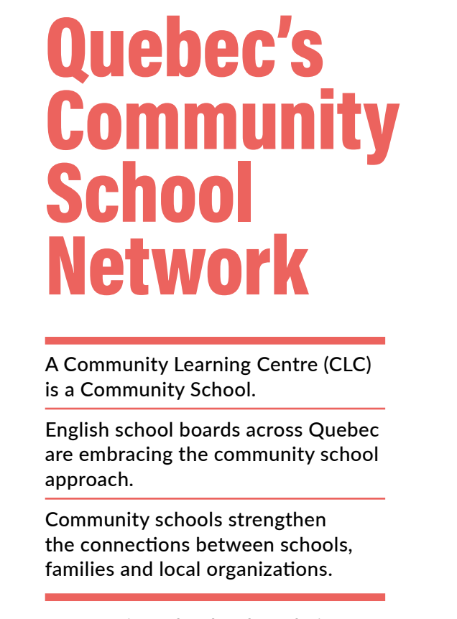
A CLC is a
Community School

Slide 4
The Importance of Partnerships
Community Learning Centres (CLCs), also known as community schools, are built around the concept of partnerships. They focus on strengthening relationships between schools, families, community organizations, and other stakeholders to improve educational outcomes and overall community well-being.
Notes:
Link to Tool What is a CLC? https://learnquebecweb.s3.ca-central-1.amazonaws.com/wp-content/uploads/sites/2/2024/07/02130503/TOOL-15-What-is-a-CLC-Community-School.pdf

Slide 5
Partnership Outcomes
Health and well-being of students & staff
Access to quality and relevant arts & culture experiences
Developing life skills and healthy habits
Environmental awareness and education
Supporting families
Intergenerational learning opportunities
Schooling as a trajectory
Notes:
CLCs focus on helping students become better learners by bringing in extra resources and opportunities.
We work with partners to offer
● Academic Support
● Health & Wellness Programming
● Community Connected Learning
● Arts, Culture and Heritage Programming
● Social Services for Students and Families
● Extracurricular Activities

Slide 6
Coming soon: LINK to YouTube replay of LEARN's Community Schools video
Notes:
Resource to review:
What is a CLC? https://learnquebecweb.s3.ca-central-1.amazonaws.com/wp-content/uploads/sites/2/2024/07/02130503/TOOL-15-What-is-a-CLC-Community-School.pdf

Slide 7
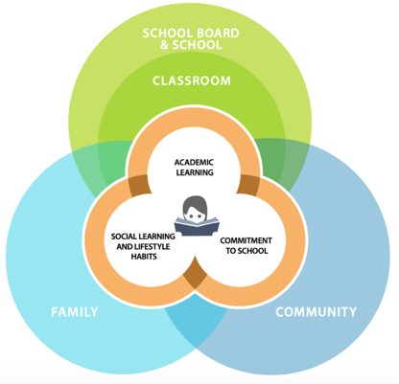
A CLC is a
Community School
Community Schools:
An ecosystem of
learning opportunities
from both in and outside
of the school
Image Source:
Reference Manual for Intervention in Disadvantaged Areas
Notes:
Everyone has a role to play - schools & school boards, families, and community – everyone is working together for the benefit of the child who is at the centre of the diagram and at the centre of everything we do.
It is a holistic perspective that is at the heart of the community schools approach.
We like to say that the student’s education is being supported by an ecosystem of learning opportunities - from both inside and outside of the school.
This ecosystemic approach also compliments what is already happening in the classroom.
School-community partnerships provide students with opportunities to engage with the community outside the school walls - giving them access to new and different learning opportunities - which contributes to student perseverance.

Slide 8
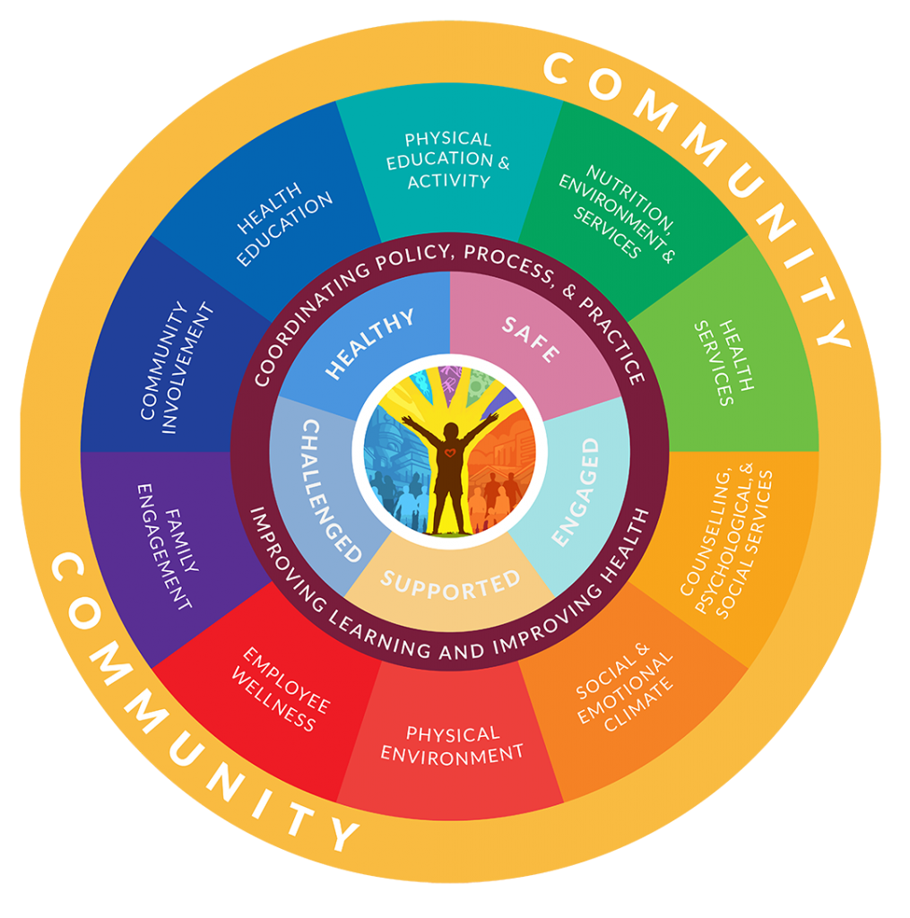
Whole School,
Whole Community,
Whole Child
Image Source: ASCD Whole Child Approach to Education
Notes:
The CLC approach has always been holistic -- Extending how we understand schools and what a child can achieve academically -- to looking at a child’s long-term development and success -- AND recognizing that everyone plays a role -- from teachers -- to schools -- to parents -- to families -- to communities -- and that we can be part or an ecosystem that helps schools communities and students thrive..
In order to have the most positive impact on the academic and wellness outcomes of students -- it is imperative that schools and communities work together.

Slide 9
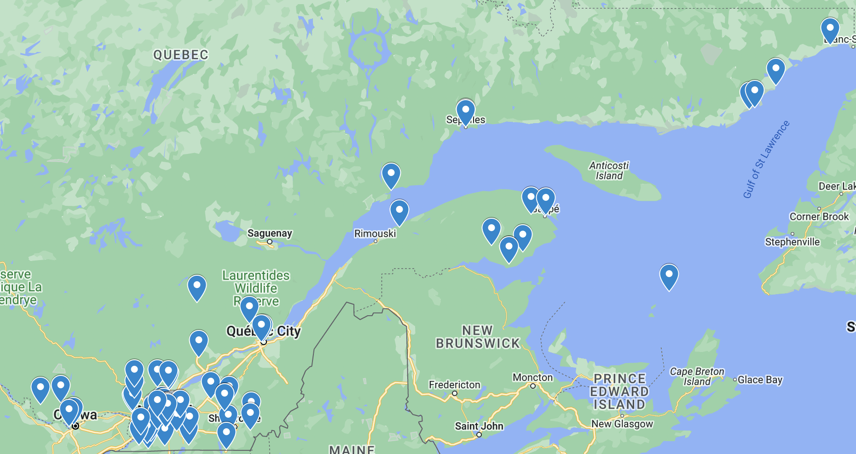
CLCs across the Province
Notes:
I invite you to take a look at the Map, and explore how wide the reach of the CLC is coast to coast
There are currently more than 90 English language schools participating in the CLC Initiative. Participating schools include elementary, high school and adult education centres located in urban, rural, and remote communities across Quebec.
Take a moment to imagine the contexts of all the different CLCs across the province, with Grosse Ile with a elementary and high school in the same building with less than 100 students, to the more urban settings with thousands of students.

Slide 10

Working with Partners
Strengthening the relationships
between
schools,
families and
community organizations
is at the heart of a CLC.
Image Source: Ylanite on Pixabay
Notes:
Leveraging local resources to meet the diverse needs of students, staff and families
The Community School approach is a systemic approach to changing school climate and culture.
There are many ways that partners can be involved in the development or the delivery of a community school project or program:
-Financial resources to get your program off the ground through grants or donations
-Material resources contributing to your program, ie. books for a library or plants for a garden
-Volunteers to help run your program
Resource:
Partnerships THE FOUNDATION OF COMMUNITY SCHOOLS
https://learnquebecweb.s3.ca-central-1.amazonaws.com/wp-content/uploads/sites/2/2024/06/25134224/TOOL-3-Partnerships.FINAL-Branded.pdf

Slide 11
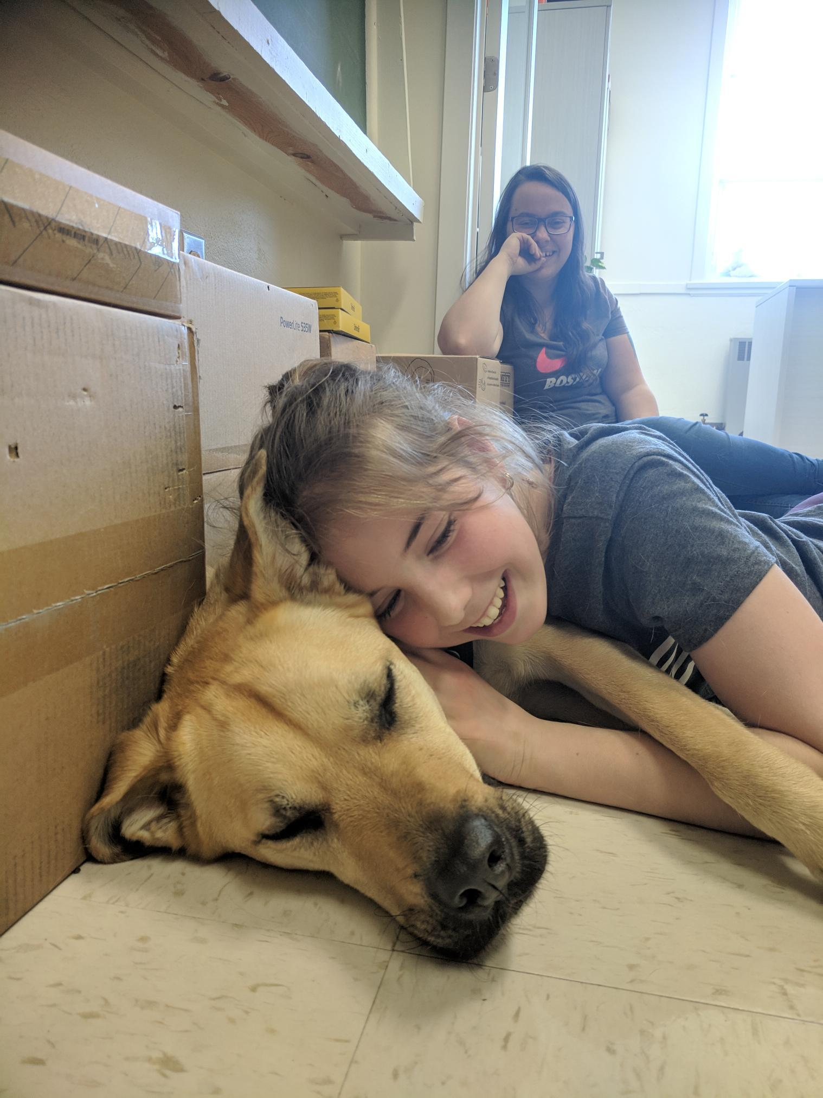

Strengthening Developmental Outcomes
Mental Health Promotion
Social & Emotional Learning
A student at Valcartier Elementary (CQSB) enjoys a cuddle with Lilo as part of a zoo therapy program.
The "whole environment changes when the dog is in the building. Students are much calmer and on task when returning to the classroom."
-Teacher, Valcartier Elementary
Notes:
Mental health and well-being is a key priority across the province.
CLCs work to find partnerships, funding, and resources to develop and support a welcoming school culture.
Promoting healthy lifestyles enhances the emotional well-being and resiliency of students and families.

Slide 12

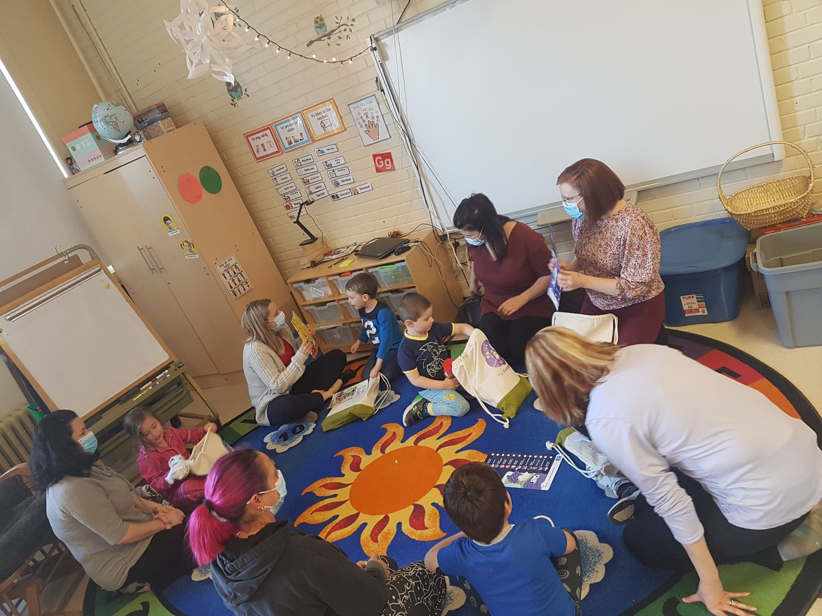
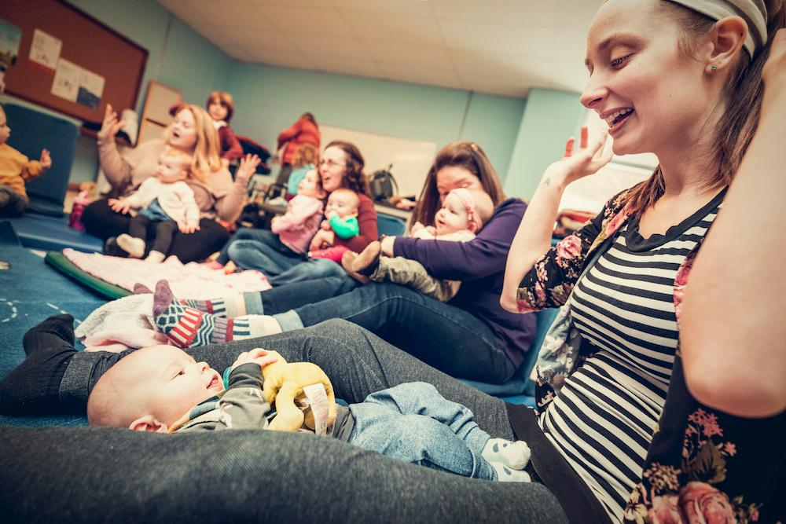
Engaging Young Families
Goodnight Bag
Mother Goose Program
Notes:
English-speaking families living in Quebec often have limited access to linguistically and culturally adapted resources to support them - including early childhood resources.
CLC schools also support the developmental needs of our little-ones as they prepare for the first transition to school.
They offer a variety of resources and activities for educators, parents and community partners - often with a focus on bilingualism and early literacy.

Slide 13
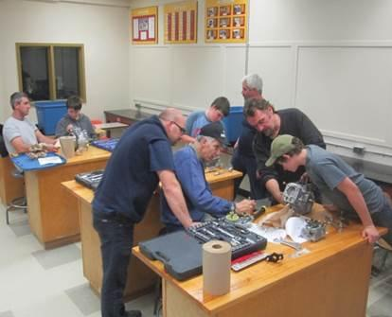
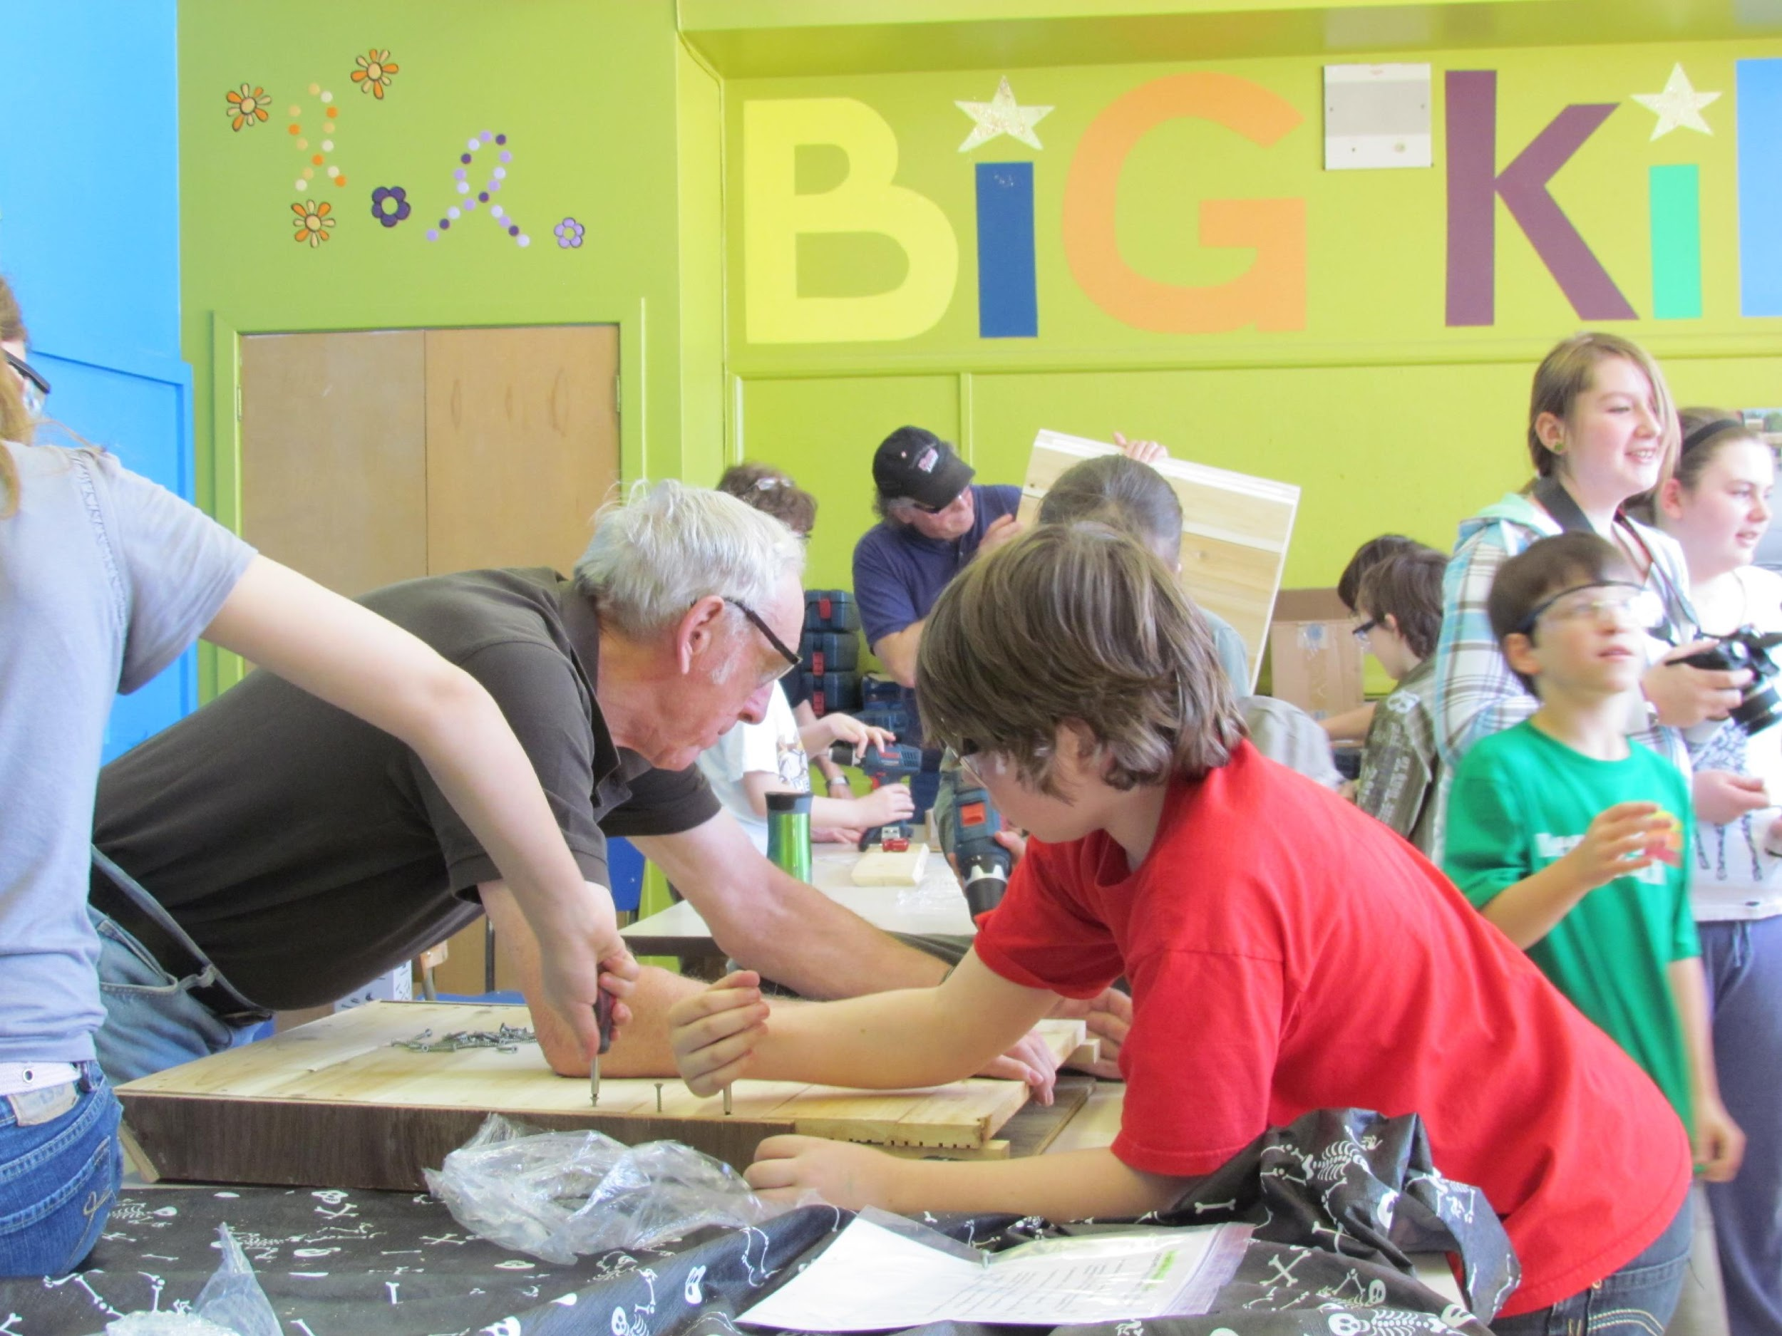
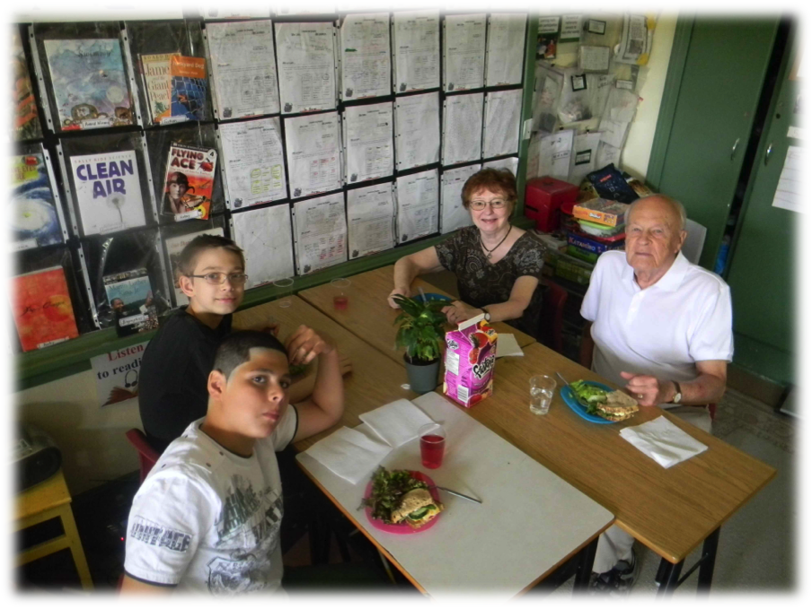
Intergenerational Learning Opportunities
Princess Elizabeth CLC
Building Bat Houses
Chateauguay Valley CLC
Small Engine Repair
Pierre Elliott Trudeau Elementary
Irish Reading Buddies
Notes:
Intergenerational programming is not only beneficial for students, it also contributes to decreasing the isolation of seniors, and offers opportunities for them to share their expertise and experiences.
Research shows that intergenerational programs increase self-esteem and feelings of well-being for both the older and younger participants. Friendships between these two generations help make communities stronger.

Slide 14
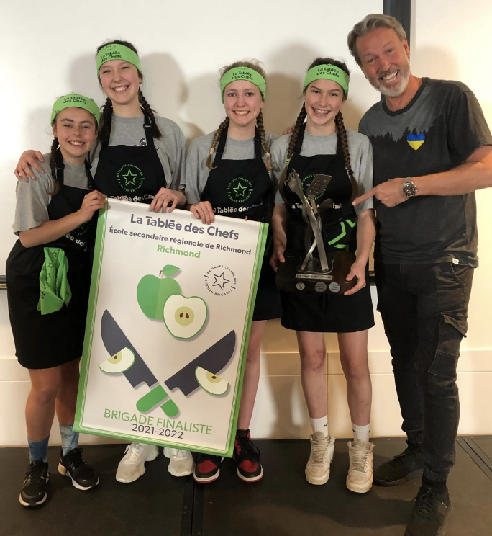
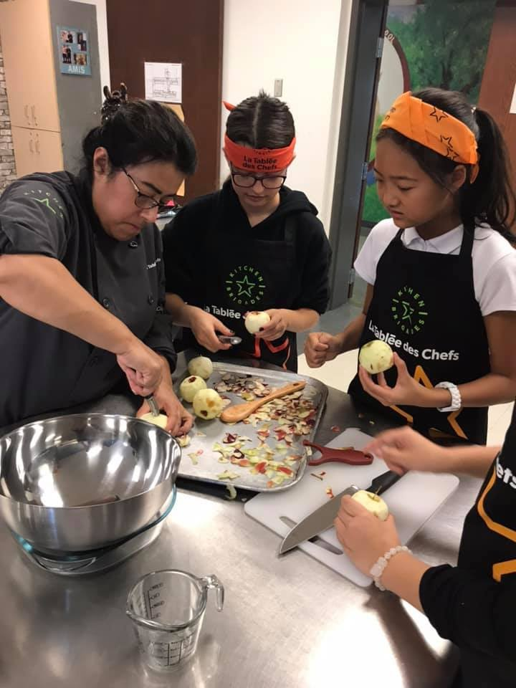
Tablée des Chefs
Seaway CLC - Kitchen Brigades
Courtesy of the Sherbrooke Record
June 8, 2022
Notes:
Community Development Agents also organize after school programing.
Kitchen Brigades is one such program - a partnership that teaches healthy cooking techniques and essential life skills to high school students
Students have access to school kitchens to learn to make meals with chefs and compete in province-wide competitions.

Slide 15
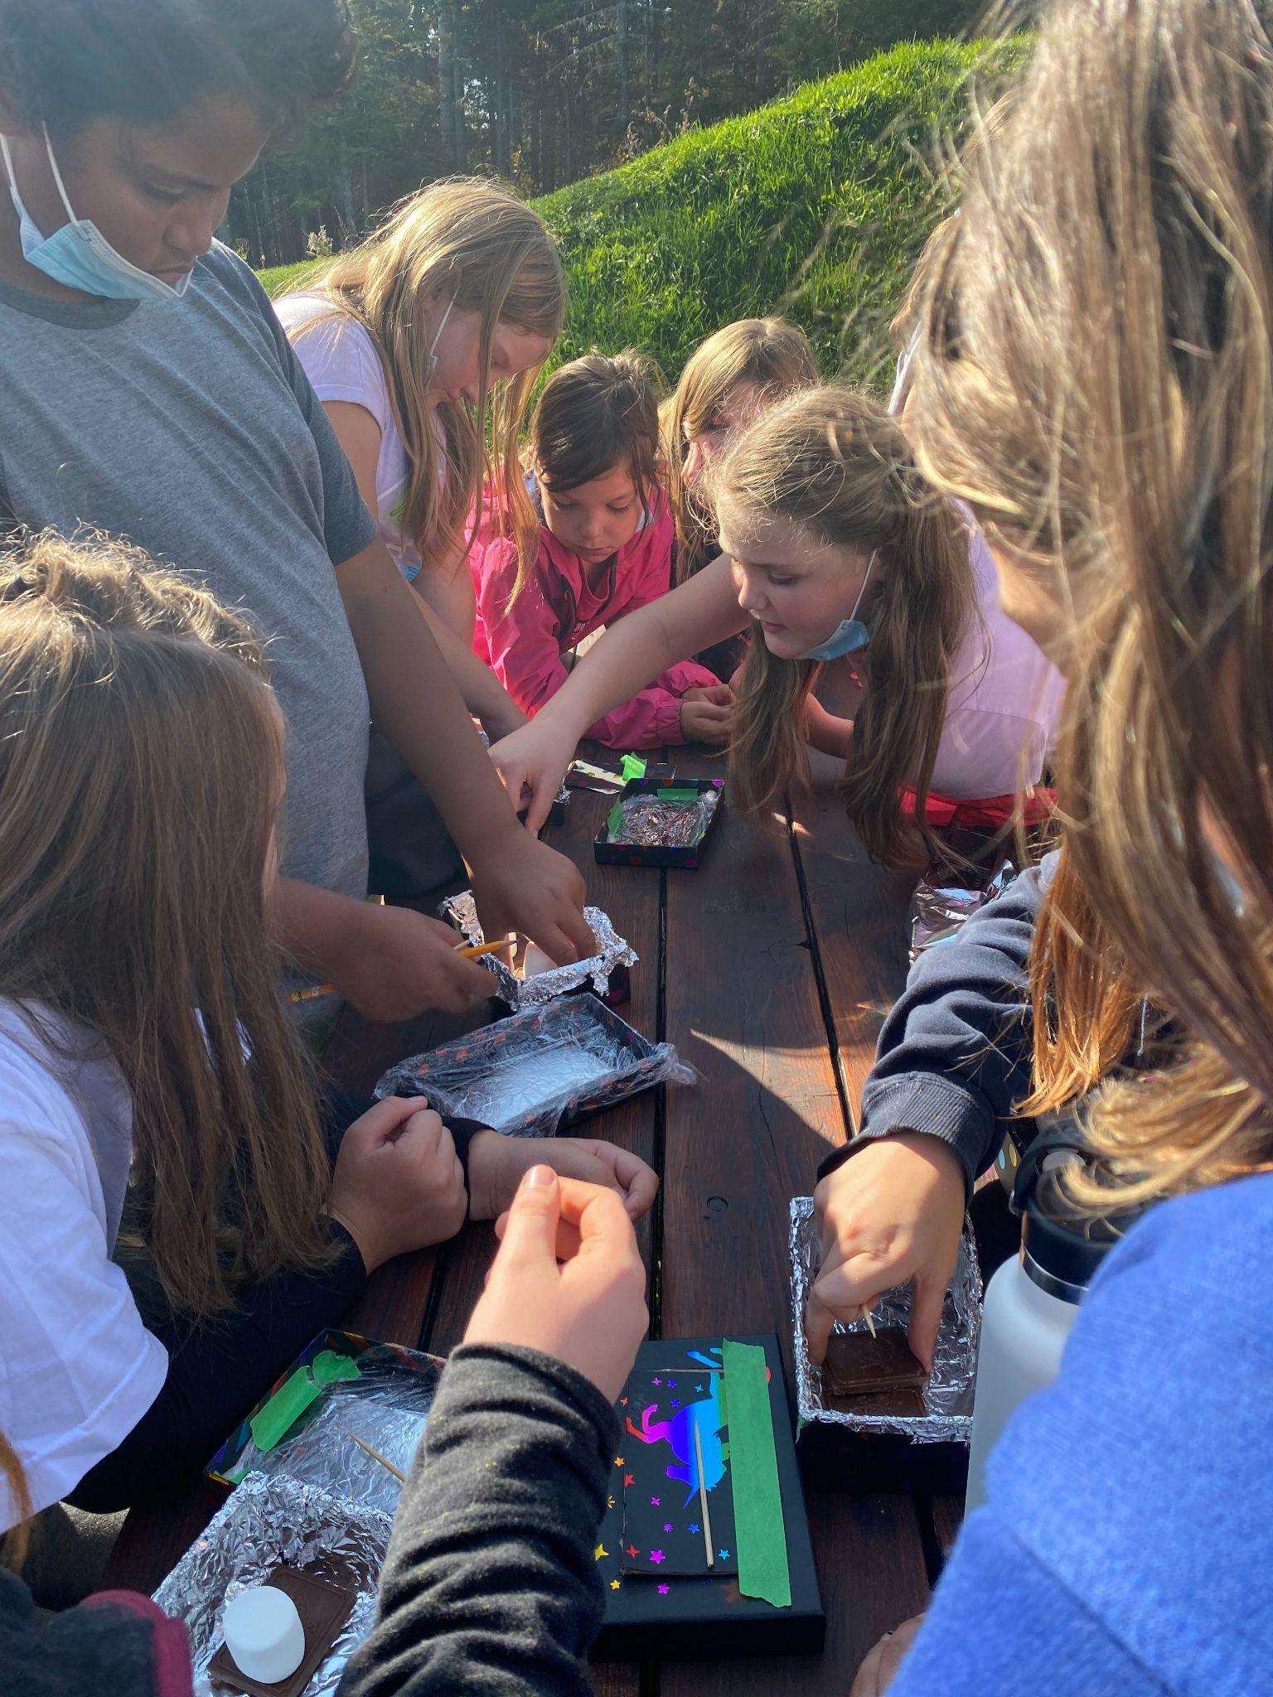
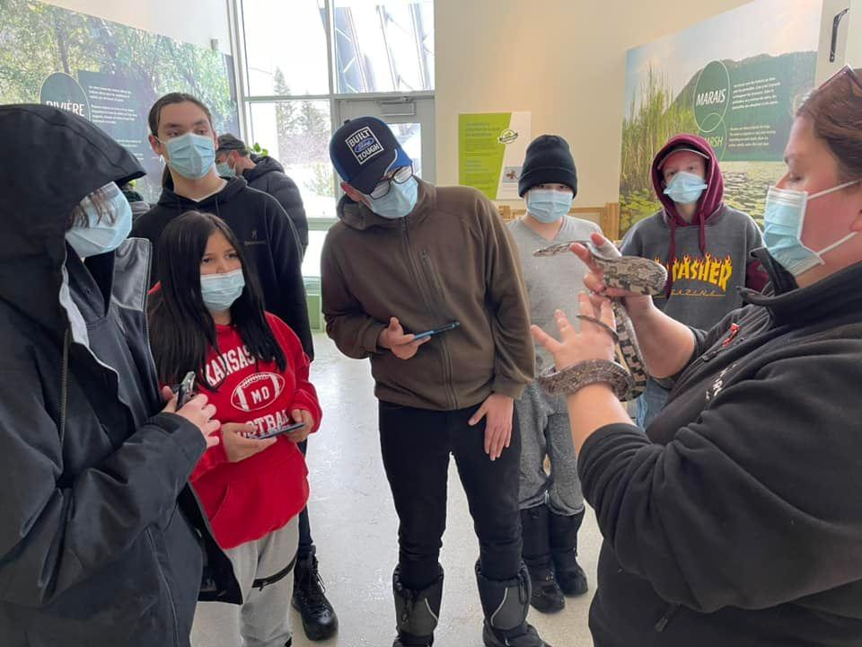


Bioparc de la Gaspesie
ESSB project:
Taking Learning Outside
Mi’kmaq Medicine Walk
Notes:
Part of mental health and wellness is going outside, for a walk or a hike to explore the natural environment.

Slide 16
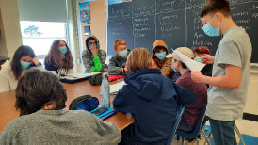
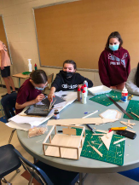
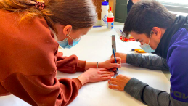
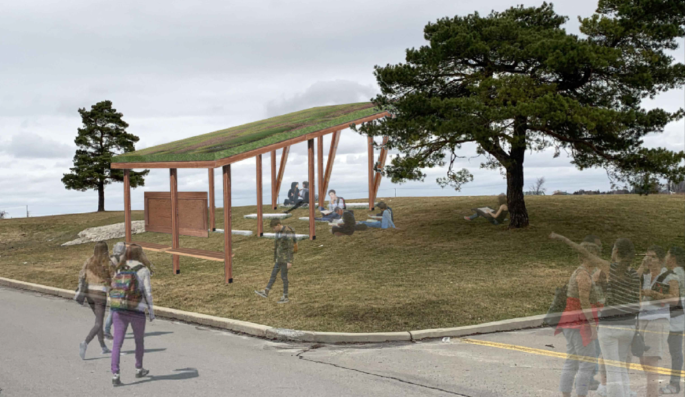
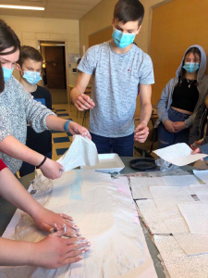
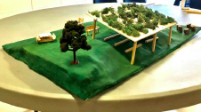
NFSB: CVR HUB CLC
Notes:
In CLCs students have also been directly involved in the design and development of an outdoor classroom to take learning beyond the four walls of a classroom.

Slide 17
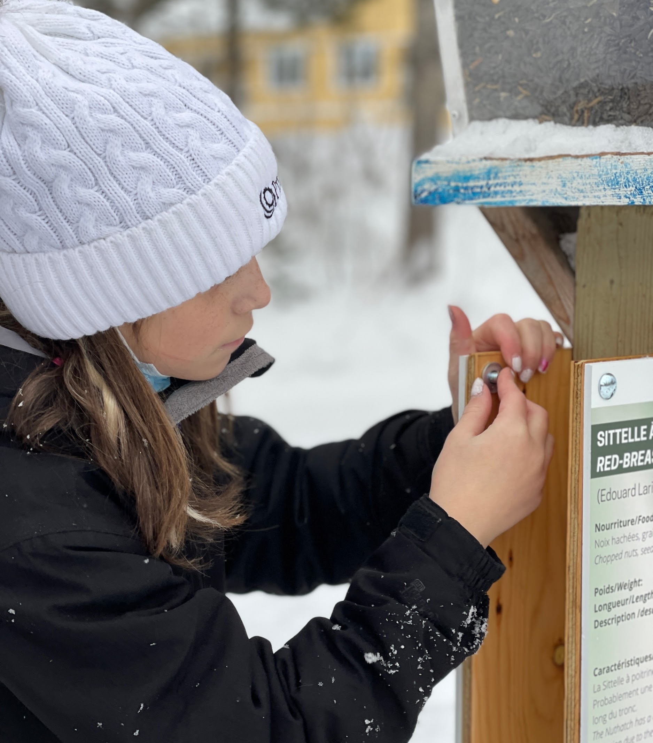
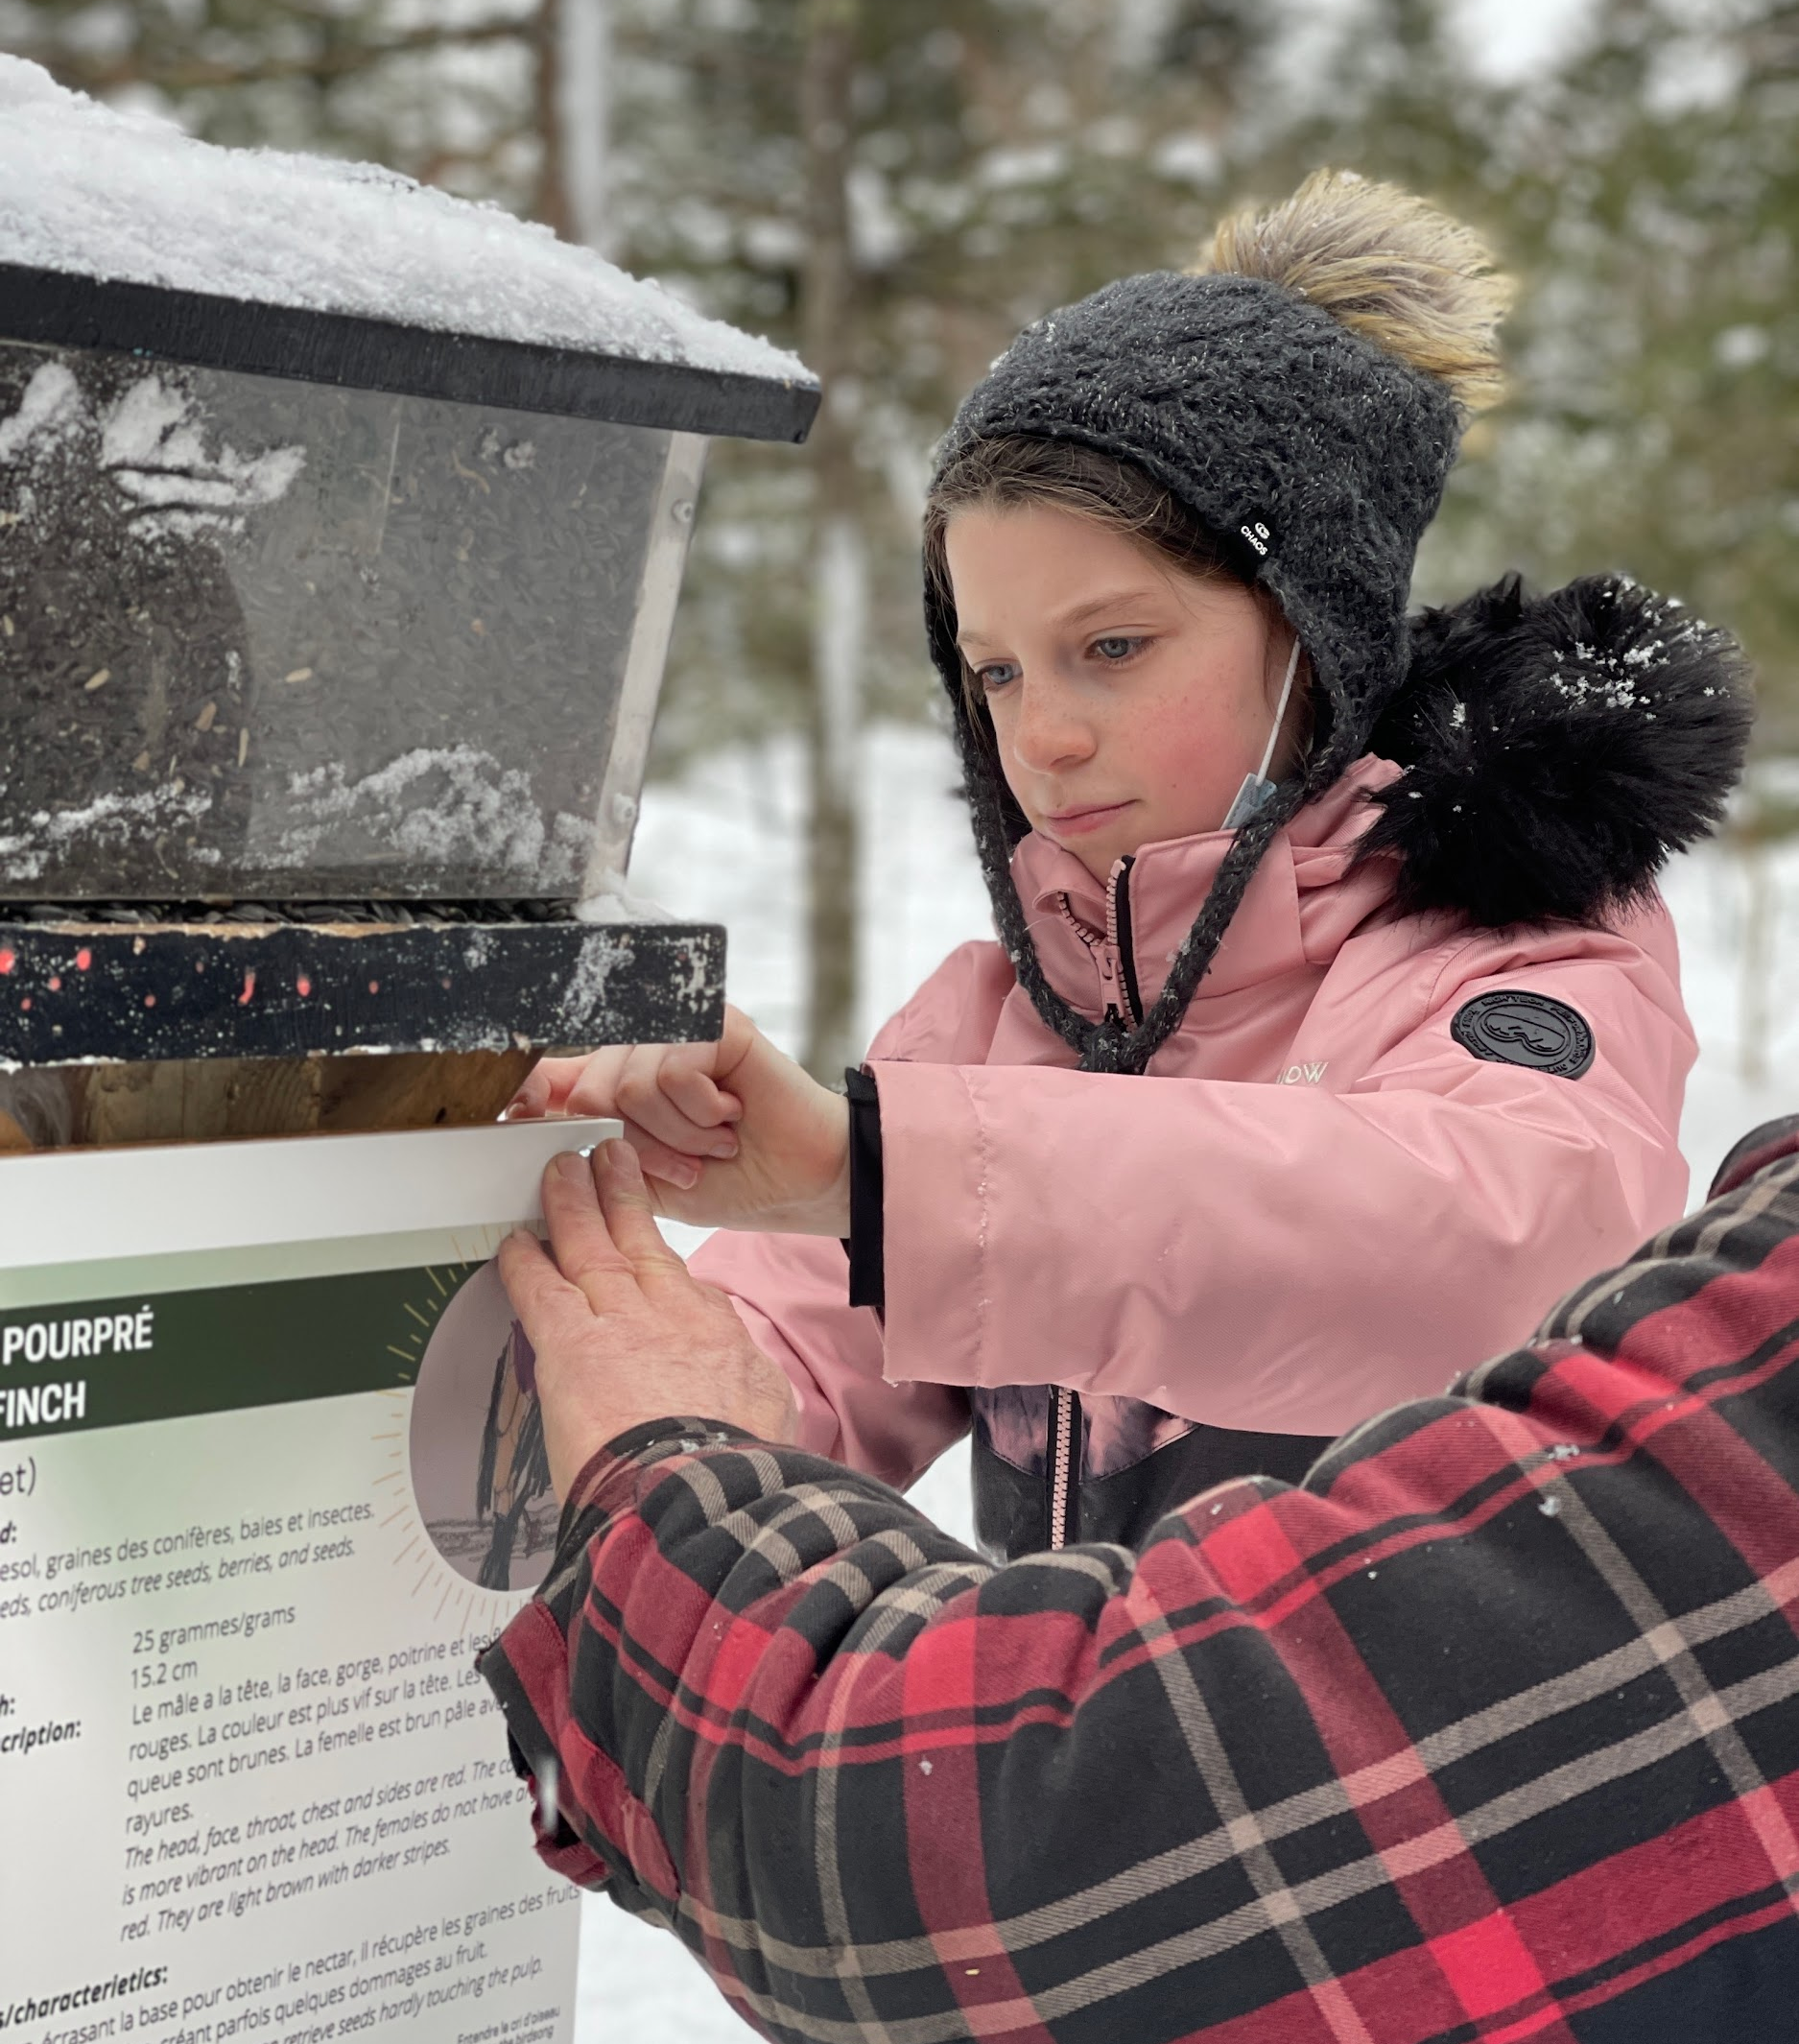

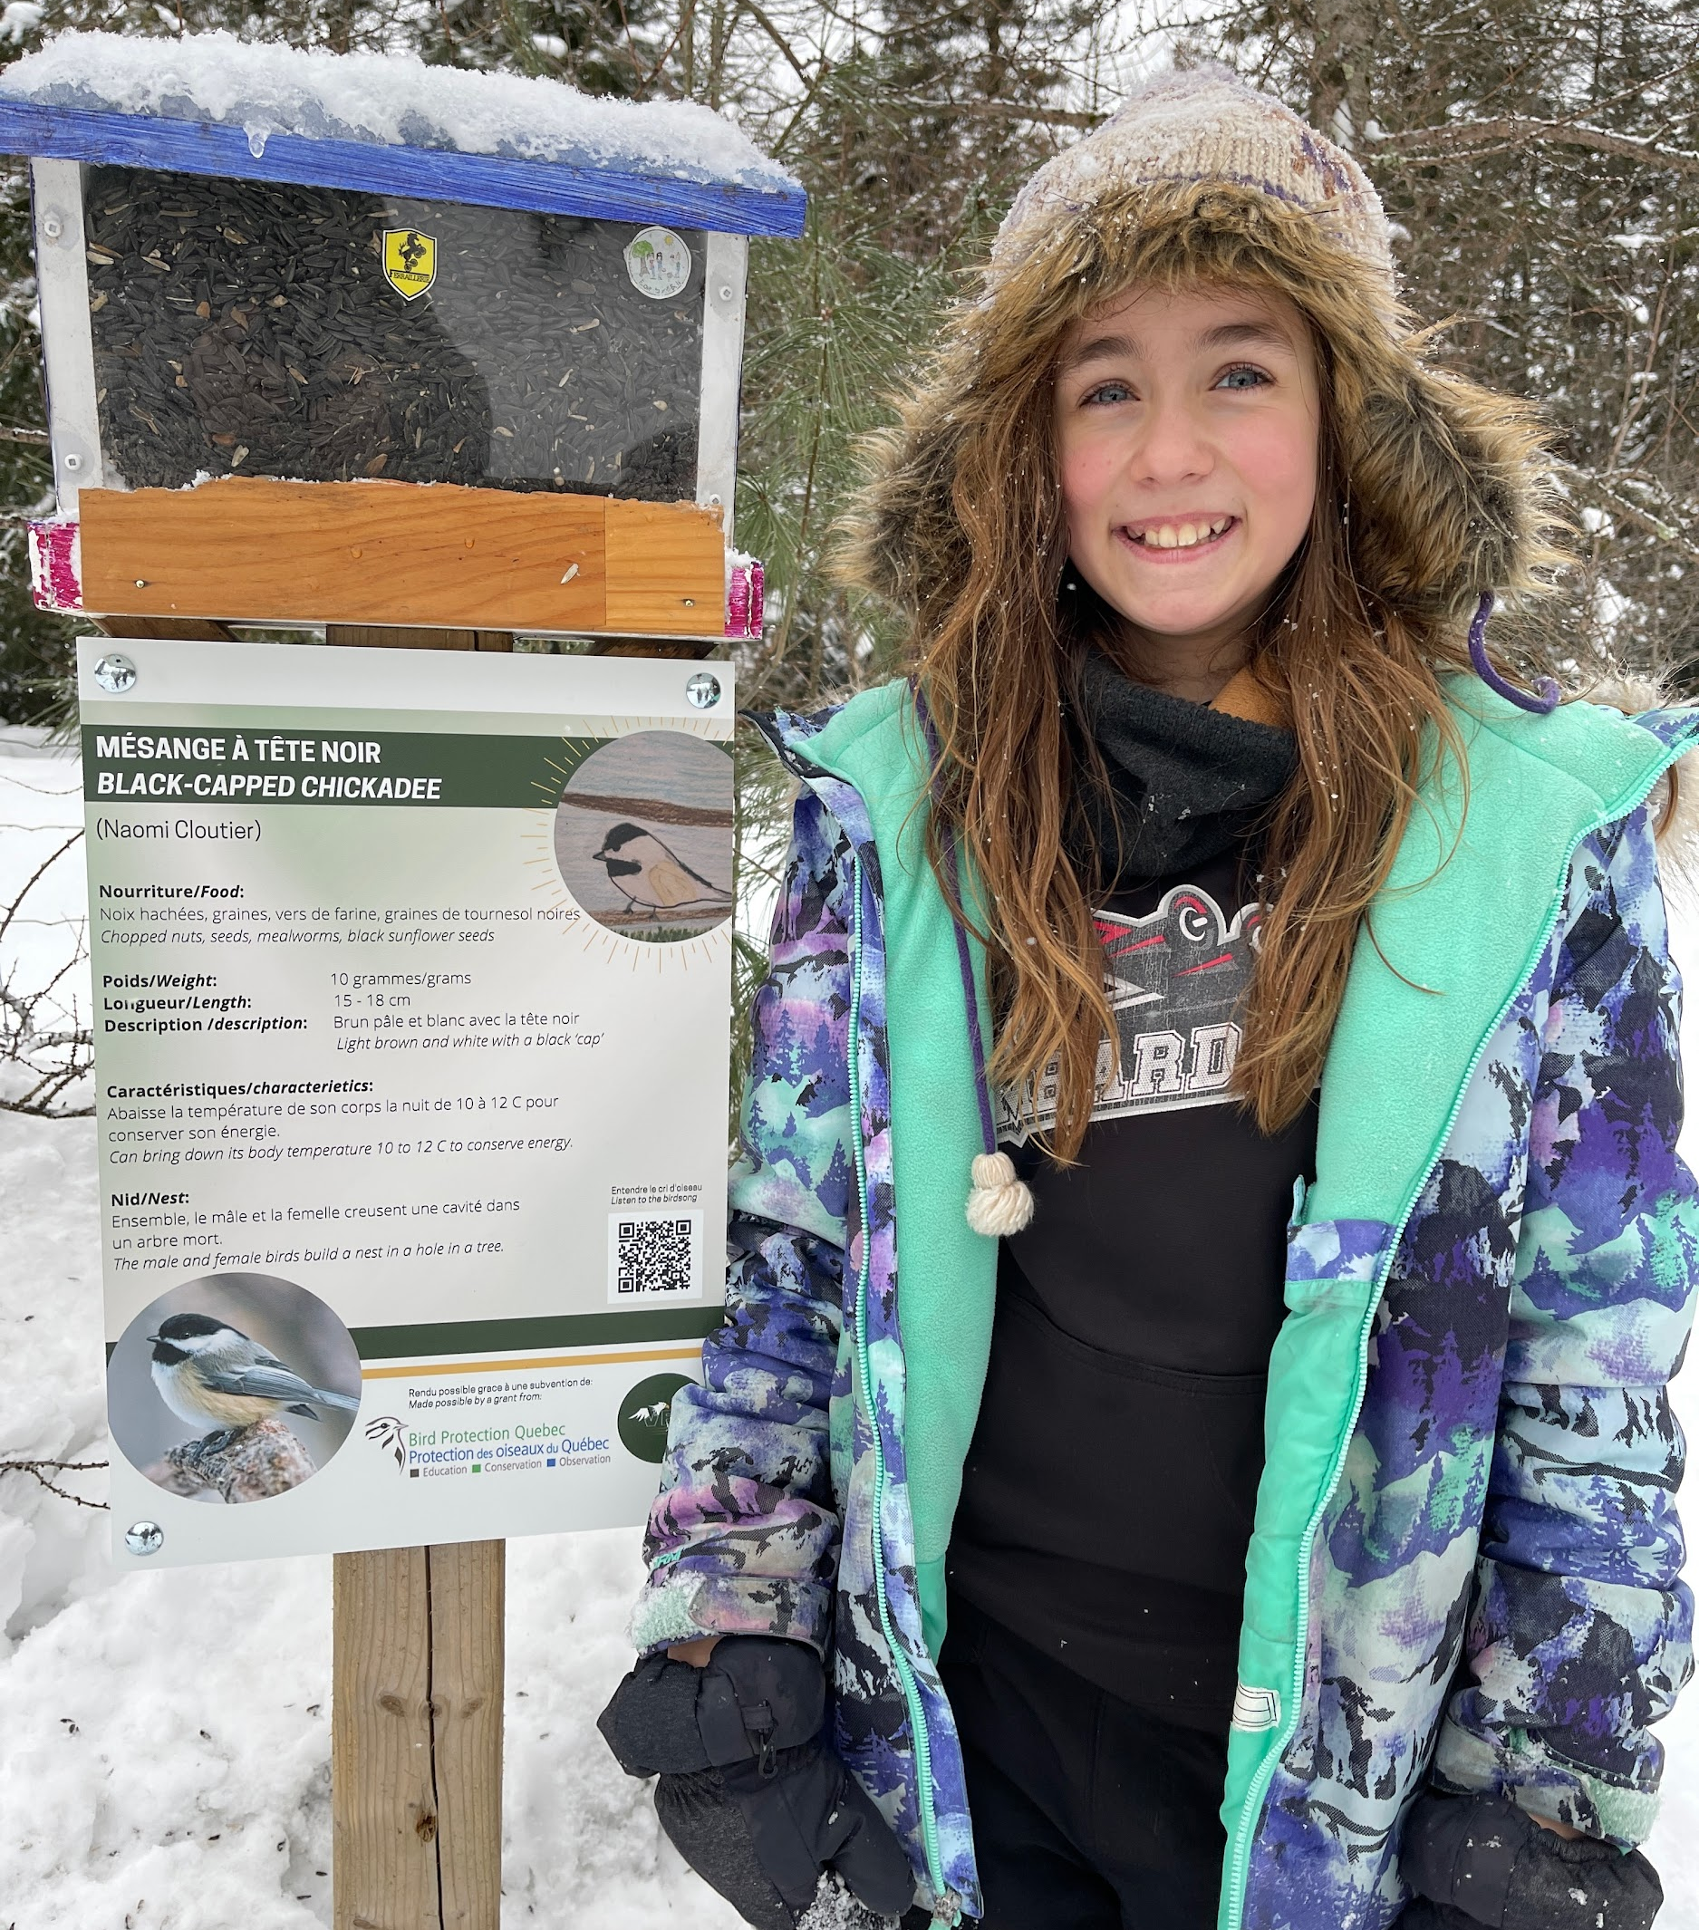
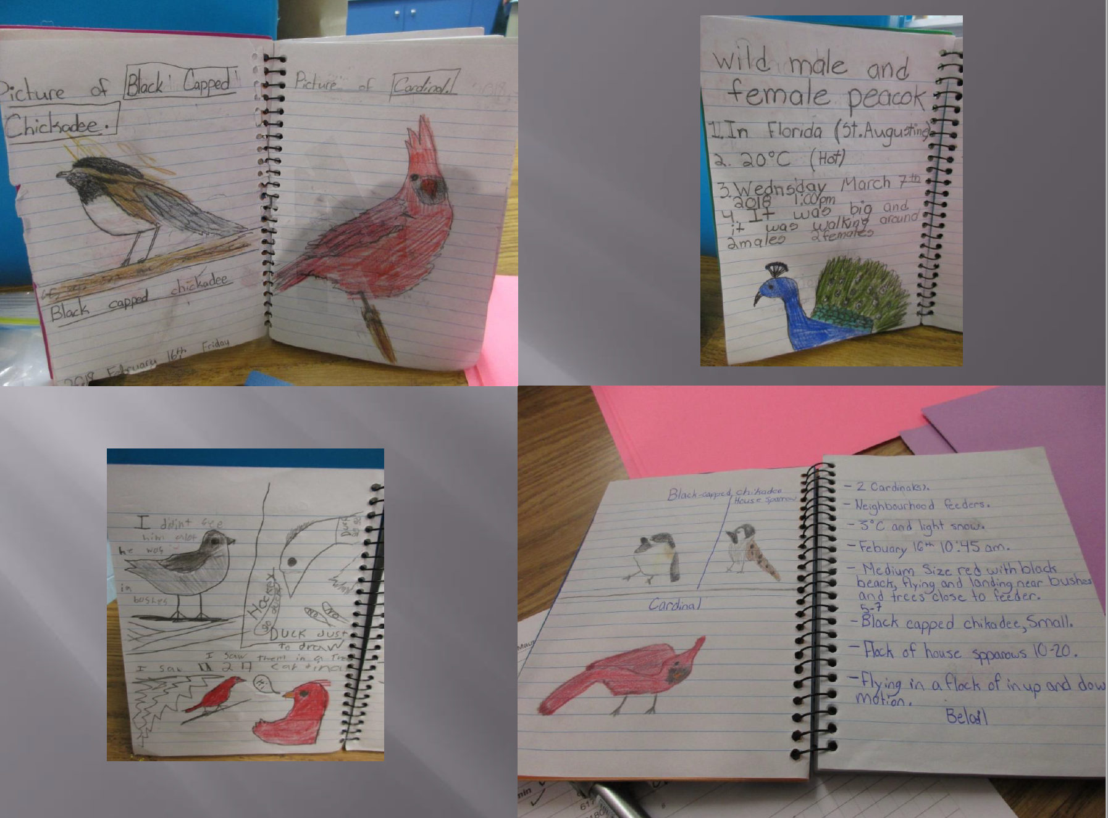
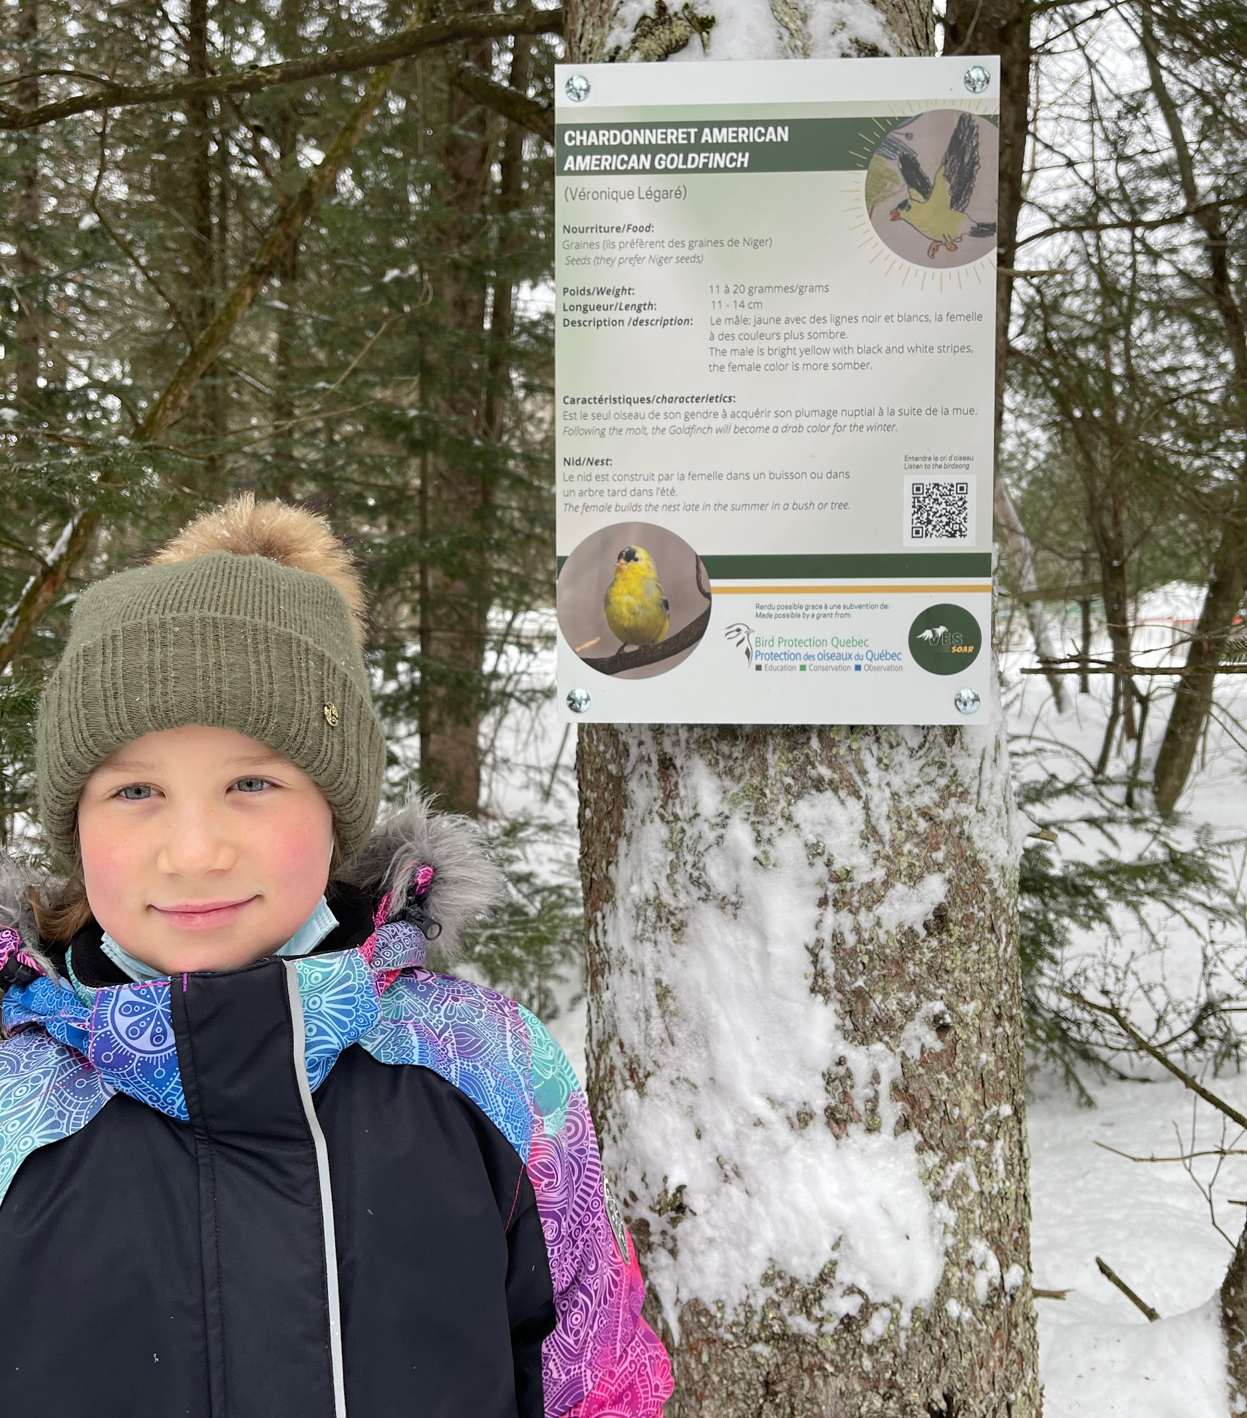
RSB:
Richelieu Valley CLC
CQSB: Valcartier
CLC
Notes:
With funds from Bird Protection Quebec, whose mandate is to foster an appreciation of birds through conservation, observation, research, and education
Our CDA, Jayne Dodderridge, at CLC Valcartier near Quebec city, secured funding from BPQ.
Students drew pictures and wrote text about birds in the area.
With some local help, the students help install these bilingual signs along the walking trails, to help visitors identify the birds.
On the southshore on Montreal , our CDA Brian Peddar worked with an educator from BPQ and Cedar Street School teacher, Maureen Caissy, Teacher RSB
Birdhouses were set up outside the classroom windows observe birds feeding outside their classroom window.
Families were also encouraged to set up bird feeders, to encourage this love of birds from home.
Students created journals to write and draw, to record their sightings
which brings together lessons in science and art

Slide 18
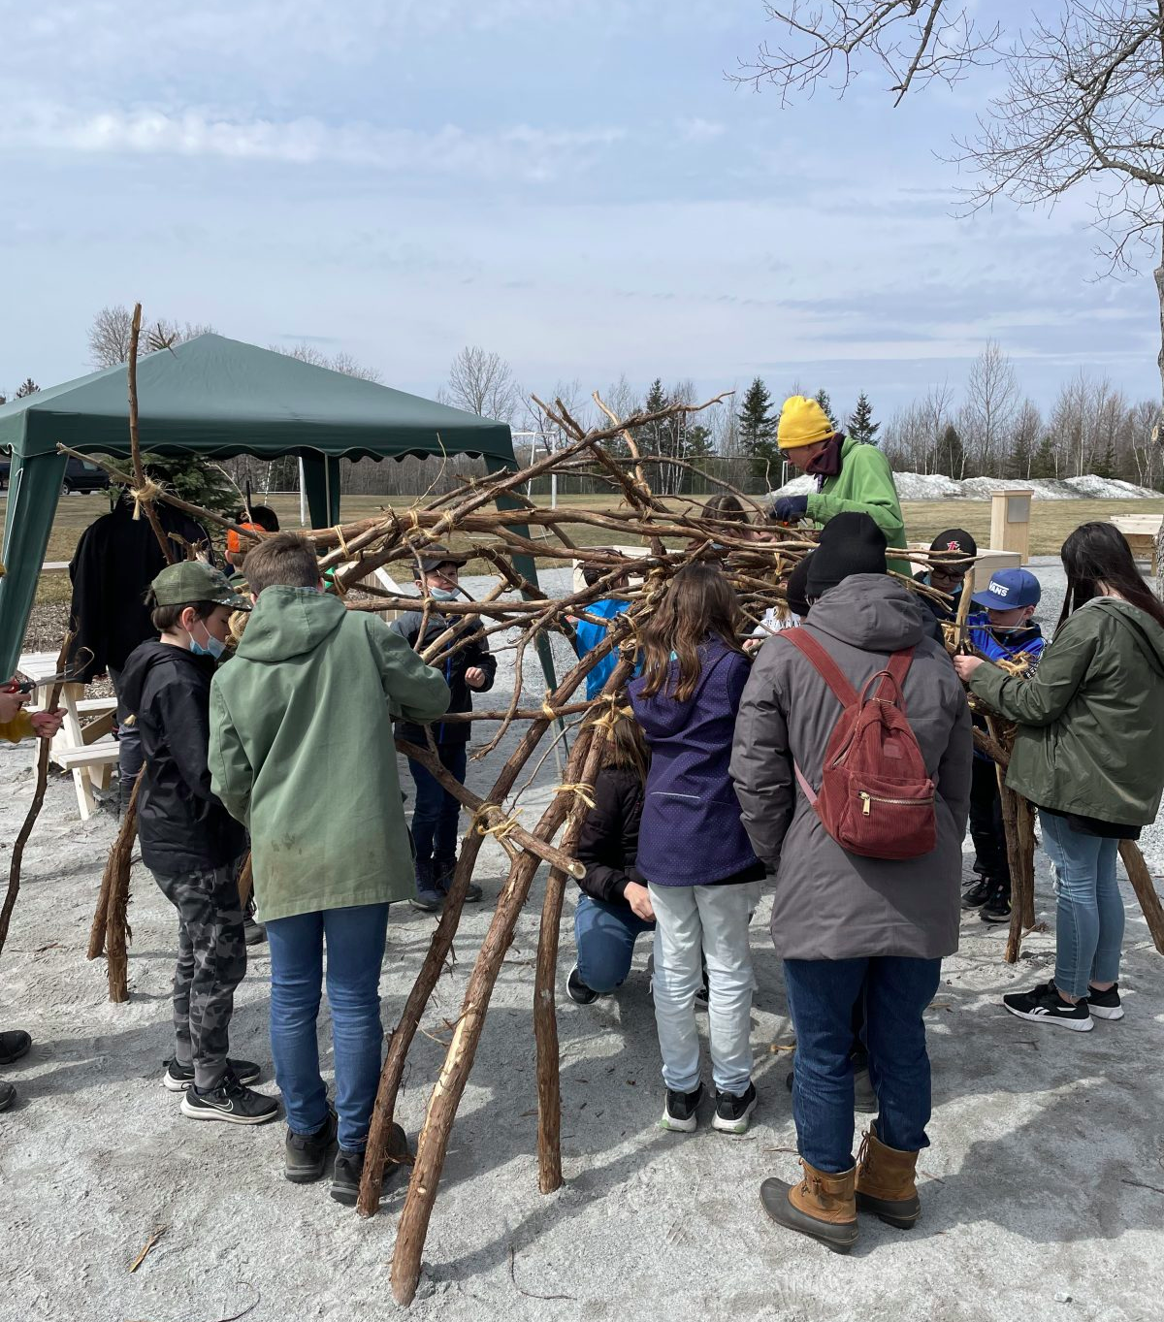
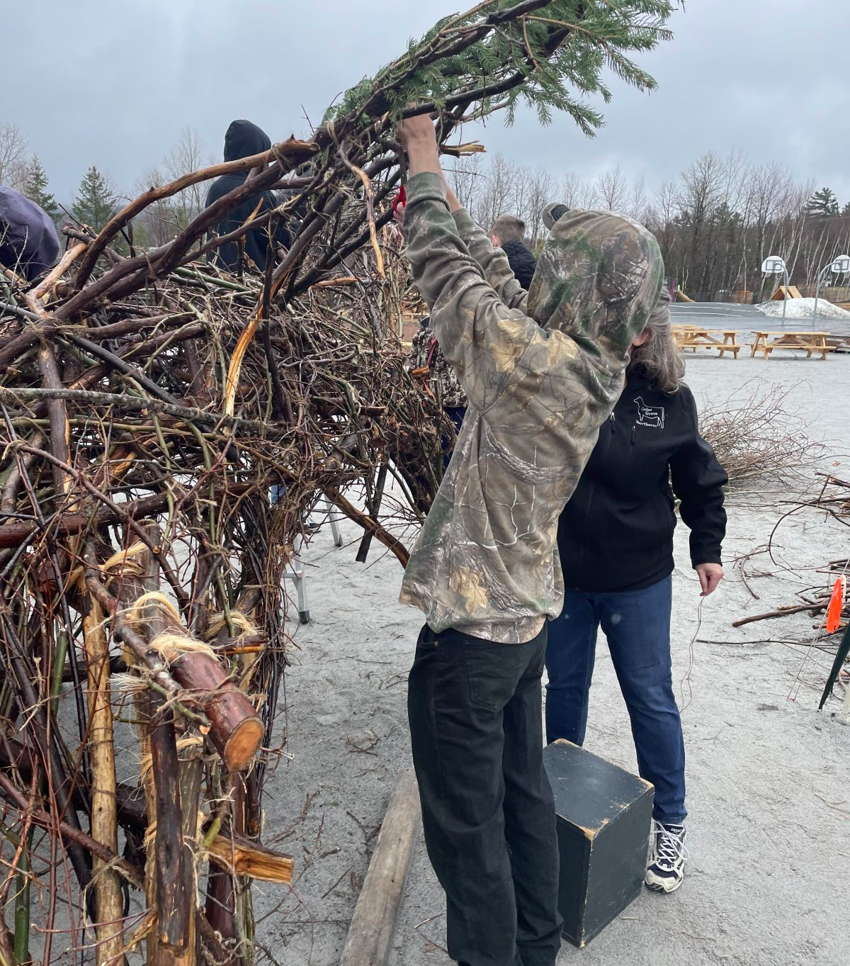
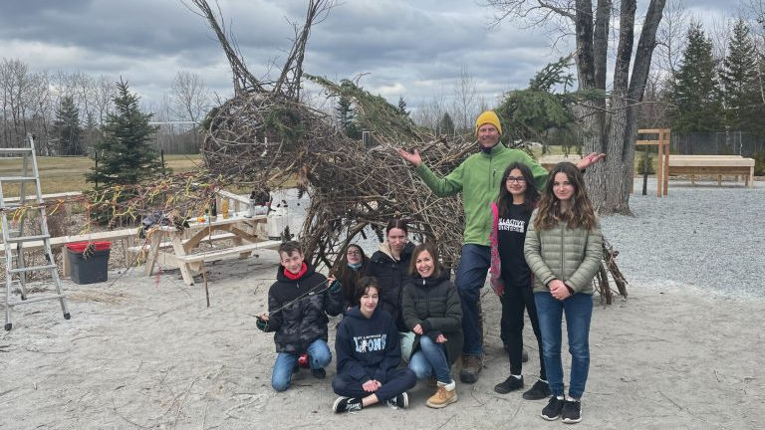
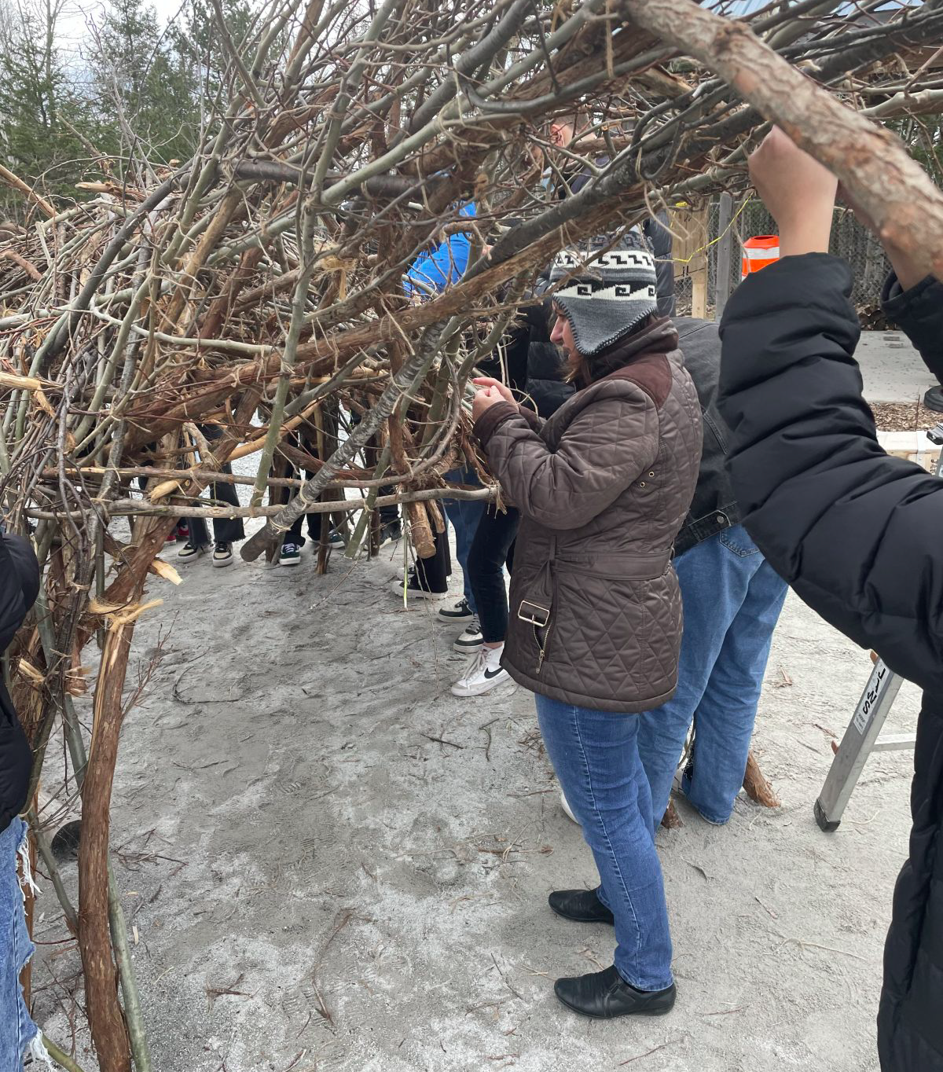
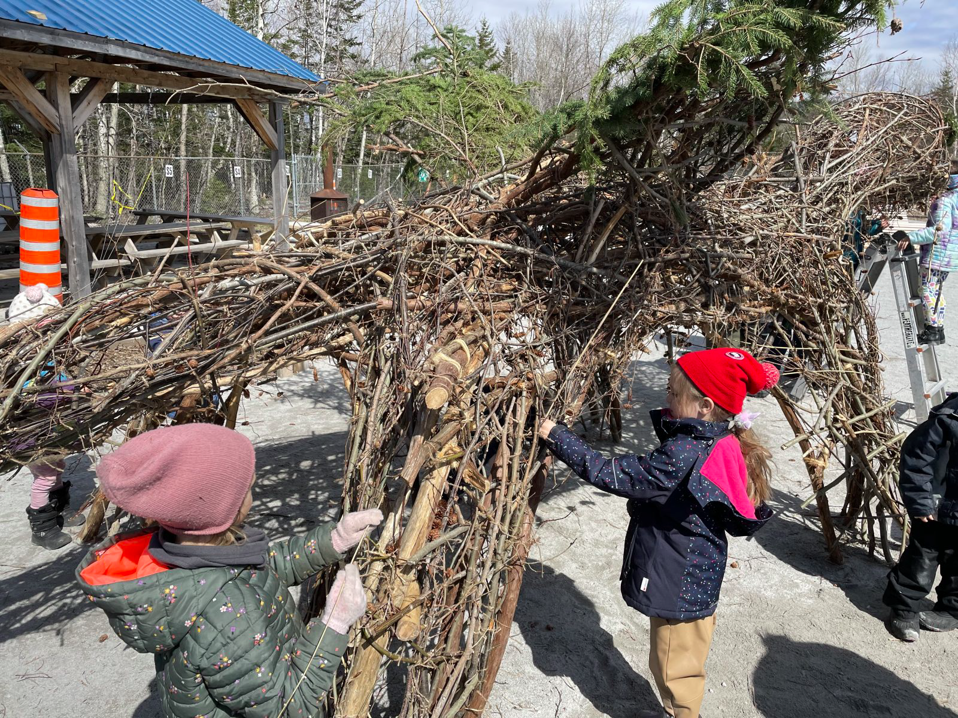
Art Project
CQSB: Thetford Mines CLC
Notes:
Our CDA David Piperno, worked with art teacher to create this project focused on outdoor land art.
The first steps were to secured funding from Culture in the Schools program and find an artist who aligned with their vision.
There were able to invite the Quebec-based Land Artist Marc Walter
to work with the whole school, from K to sec 5, including teachers and students
The branches were collected from local community.
Building the sculpture next to the school's outdoor learning space was very open-ended as it was fueled by creativity and imagination
as there was not plan to what the creature would look like in the end.

Slide 19
Examples of Programs in our CLC
Notes:
Add your photos and text to this slide to show examples of your CLC

Slide 20
In-class Examples of CLC activities from our CLC
Notes:
Add your photos and text to this slide to show examples of your CLC

Slide 21
Student life (after school activities) in our CLC
Notes:
Add your photos and text to this slide to show examples of your CLC

Slide 22
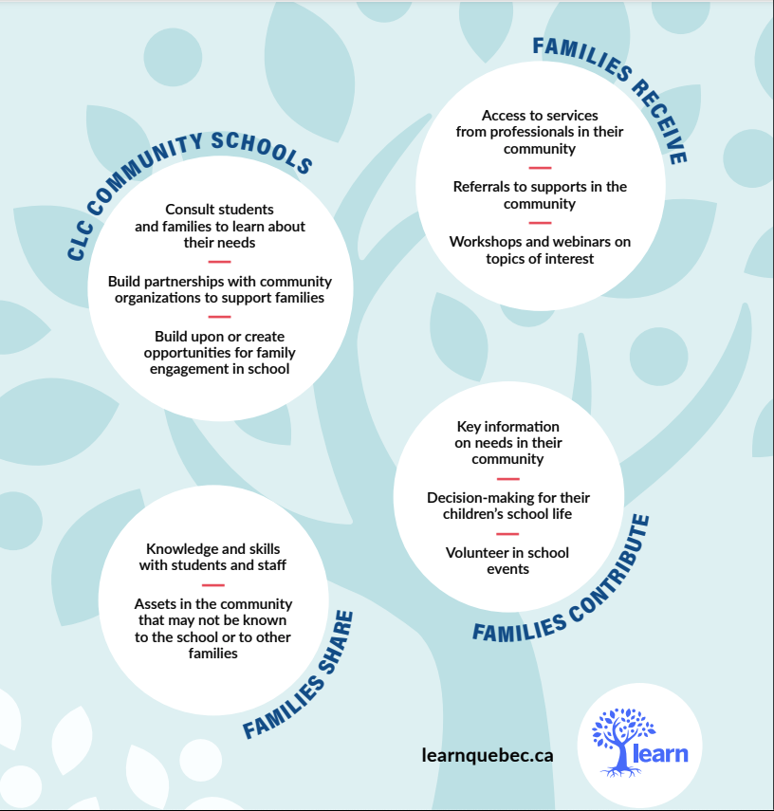
Families and CLCs
Notes:
Leveraging local resources to meet the diverse needs of students, staff and families
Review these Resources to pitch the benefits of CLCs for Families:
How CLC Community Schools Support Families
https://learnquebecweb.s3.ca-central-1.amazonaws.com/wp-content/uploads/sites/2/2024/06/25143044/TOOL-11-How-CLCs-Support-Families.pdf
ENGAGING FAMILIES IN CLC COMMUNITY SCHOOLS Why it’s Important
https://learnquebecweb.s3.ca-central-1.amazonaws.com/wp-content/uploads/sites/2/2024/06/25152214/TOOL-2-Engaging-Families-in-CLC-Community-Schools_FINAL.pdf

Slide 23
A CLC is about Partnerships
WE VALUE
Family Engagement
Lifelong Learning
Environmental Sustainability and Stewardship
Vibrant Communities
Parent & Community Involvement
Community Partnerships
WE WORK WITH PARTNERS TO OFFER
Academic Support
Health & Wellness Programming
Community Connected Learning
Arts, Culture and Heritage Programming
Social Services for Students and Families
Extracurricular Activities
Notes:
Leveraging local resources to meet the diverse needs of students, staff and families

Slide 24
Who is in Our Area?
Non-profit organizations - various sectors
Municipalities - MRC
Community green spaces
Local Businesses
Schools, CEGEPS & Universities
Local media
Senior centres
Notable community members
Notes:
Leveraging local resources to meet the diverse needs of students, staff and families
If you have connections already in place, or know the name of a contact person, please let me know.
We can work together to develop projects and programs that suit the needs of your students and classroom.
Do you see any gaps or connections?
This conversation ties into Community Asset Mapping.
School Community Asset Map:
https://drive.google.com/file/d/1BpLfibI1GUxFq_6TsmseRtUZcr2vzfm1/view

Slide 25
Where you can reach me:
Contact Information

